Slide 1


CAPSTONE PROJECT
AI Powered Email and Notice Agent
PRESENTED BY: Janmejay Y. Pandya
STUDENT NAME: Janmejay Y. Pandya
COLLEGE NAME: LDRP- ITR
DEPARTMENT: Computer Engineering
EMAIL ID: janmejay.pandya.ldrp@gmail.com

Slide 2
OUTLINE:
Problem Statement
Proposed System/Solution
System Development Approach (Technology Used)
Algorithm & Deployment
Result (Output Image)
Conclusion
Future Scope
References

Slide 3
PROBLEM STATEMENT:
In academic institutions and office environments, drafting official emails, notices, and circulars is a frequent and essential task. However, many students, faculty members, and administrative staff face difficulties in maintaining a consistent professional tone, proper formatting, and correct grammatical structure while preparing such communications.
Manual drafting of formal communications is time-consuming and often leads to inconsistencies, unclear messaging, or deviations from institutional communication standards. Additionally, users may struggle to rewrite informal messages into appropriate academic or office-style content, especially when required details such as subject, date, or intended audience are missing.
As a result, there is a need for a reliable system that can assist users in creating clear, structured, and professional academic and office communications efficiently, while ensuring adherence to standard institutional guidelines.

Slide 4
PROPOSED SOLUTION:
The proposed system is an AI-based Email & Notice Drafting Agent developed using Microsoft Copilot Studio to support academic and office communication needs. It assists users in drafting professional emails, notices, and circulars with appropriate tone and structure.
The agent enables conversion of short instructions or bullet points into complete, well-formatted official communications and allows rewriting of existing content into formal, polite, or student-friendly language as required.
The system follows predefined institutional communication guidelines, ensuring grammatical accuracy, clarity, and consistency. It also intelligently identifies missing information such as subject, date, or intended audience and prompts the user to provide the required details.
The solution integrates seamlessly with Microsoft 365 applications such as Outlook and Word, improving productivity, reducing manual drafting effort, and ensuring reliable, standardized official communication.

Slide 5
SYSTEM APPROACH:
System Requirements:
Software Requirements:
Microsoft Copilot Studio
Microsoft 365 (Outlook and Word)
Web browser (Microsoft Edge or Google Chrome)
Stable internet connection
Hardware Requirements:
Processor: Intel Core i3 or higher
RAM: Minimum 8 GB
Storage: At least 5 GB free disk space
Device: Laptop or Desktop system

Slide 6
SYSTEM APPROACH:
System Development Approach:
The system was developed using Microsoft Copilot Studio, focusing on creating an instruction-driven AI agent tailored for academic and office communication tasks.
A structured prompt design approach was followed, defining clear roles, responsibilities, and behavioral rules for the agent to ensure professional and consistent outputs.
The agent workflow was designed to analyze user input, determine the required document type (email, notice, or circular), and apply appropriate formatting and tone.
Validation logic was incorporated to identify missing information such as subject, date, or audience, prompting the user before generating the final draft.

Slide 7
SYSTEM APPROACH:
Technology Used:
Microsoft Copilot Studio – Used to design, configure, and manage the AI-based communication drafting agent.
Large Language Model (LLM) – Utilized for natural language understanding, content generation, and tone adaptation.
Microsoft 365 Integration – Enables seamless drafting and editing within Outlook and Word.
Prompt Engineering & Rule-Based Instructions – Ensures adherence to institutional communication standards and controlled content generation.

Slide 8
ALGORITHM & DEPLOYMENT:
1. Algorithm Selection:
An instruction-driven Large Language Model (LLM) is selected and configured using Microsoft Copilot Studio. This approach is suitable for generating structured, context-aware academic and office communications based on user instructions without requiring complex data processing.
2. Data Input:
The algorithm takes user-provided text inputs such as brief instructions, bullet points, or informal messages. Additional inputs include tone preference (formal, polite, or student-friendly) and document type (email, notice, or circular).
3. Training Process:
The system does not require traditional model training. Instead, it relies on prompt engineering and predefined instructions to guide the LLM’s behavior, ensuring adherence to institutional communication standards and consistent output quality.
4. Prediction / Generation Process:
Based on the validated inputs, the algorithm generates a complete, grammatically correct, and well-structured communication draft. If essential details are missing, the system prompts the user before final content generation.

Slide 9
ALGORITHM & DEPLOYMENT:
Deployment:
The agent is deployed using Microsoft Copilot Studio within the Microsoft 365 cloud environment.
It integrates seamlessly with Outlook and Word, enabling real-time drafting and editing of communications.

Slide 10
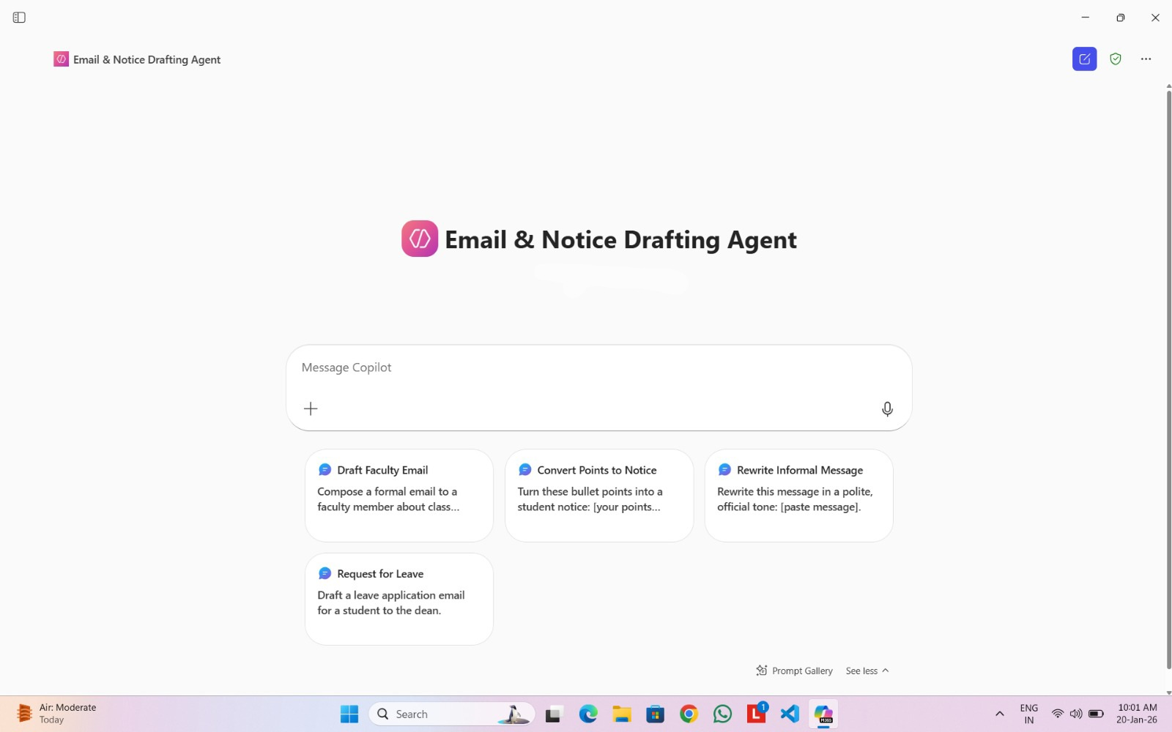
RESULT:

Slide 11
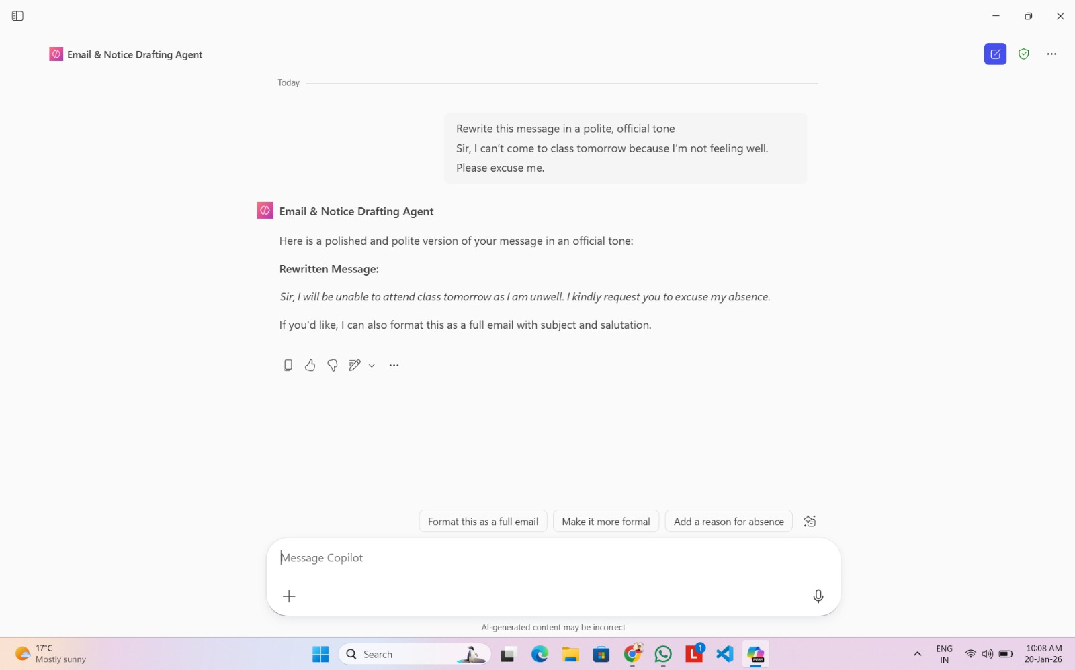
RESULT:

Slide 12
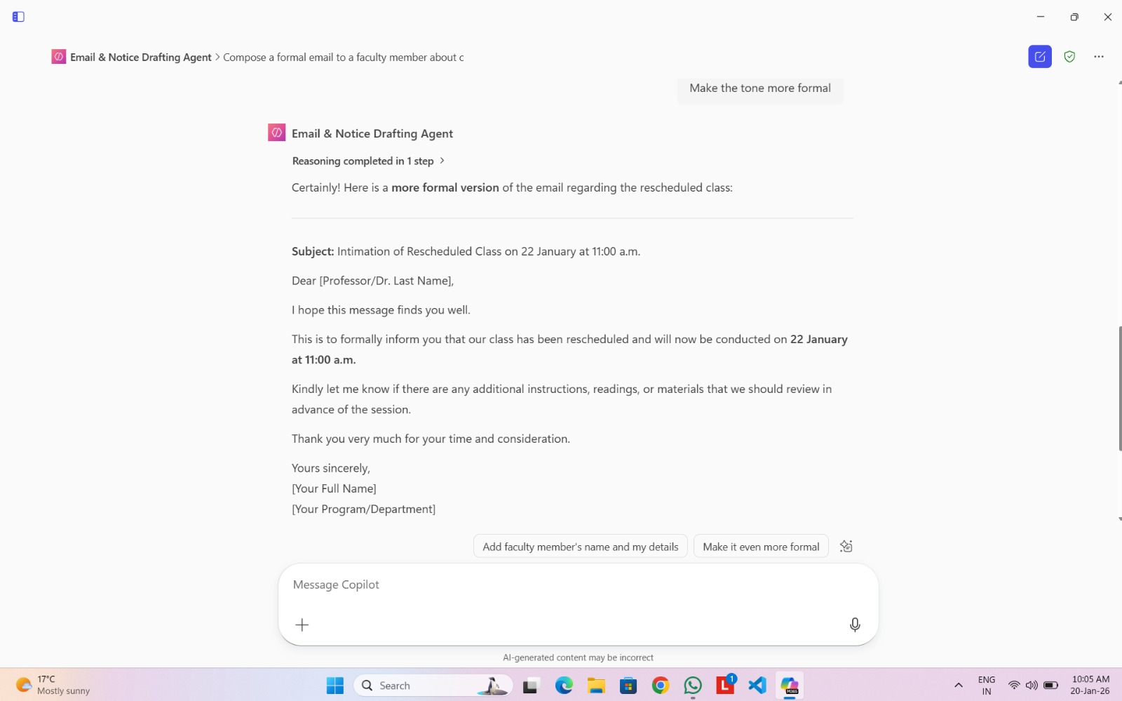
RESULT:

Slide 13
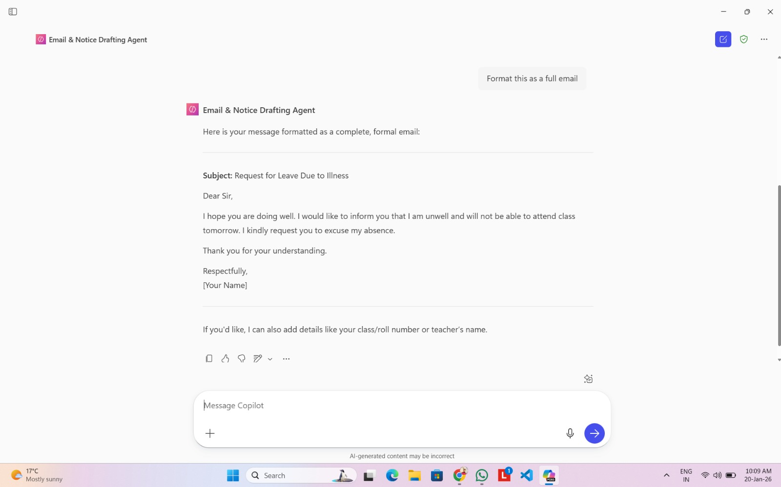
RESULT:

Slide 14
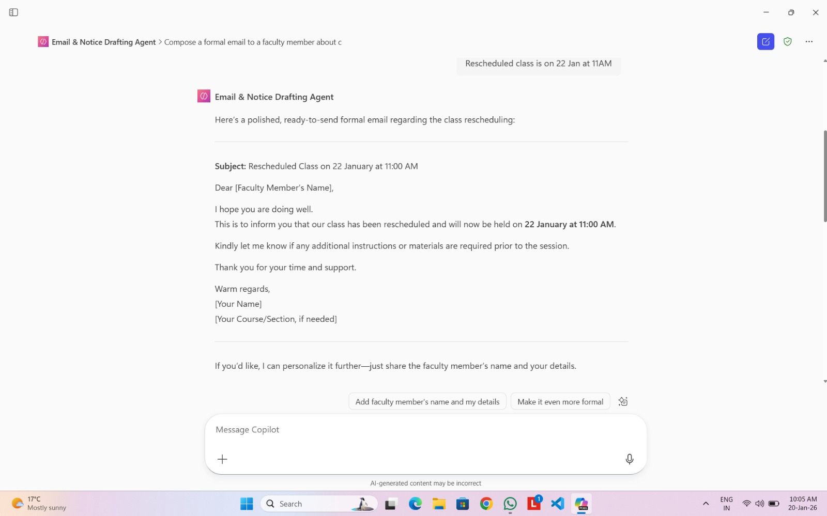
RESULT:

Slide 15
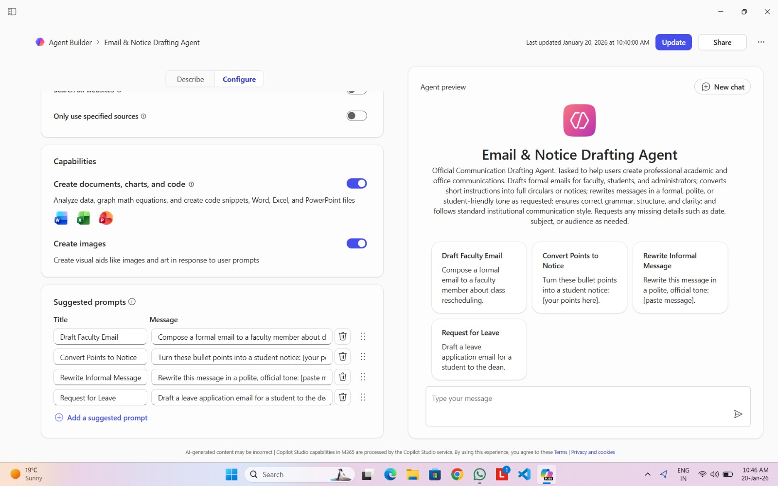
RESULT:

Slide 16
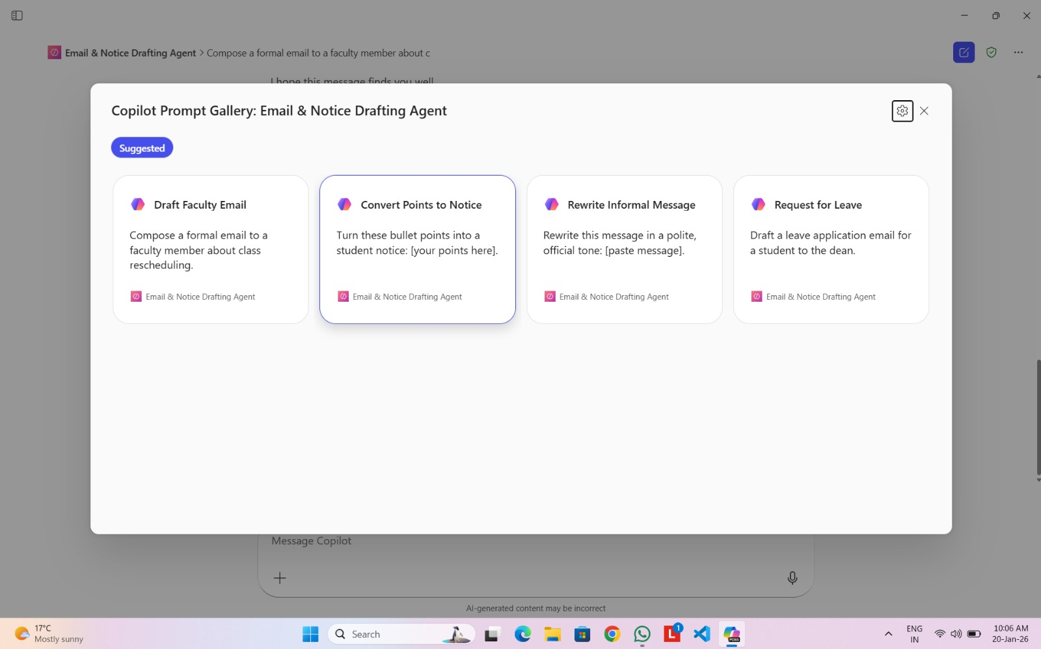
RESULT:

Slide 17
CONCLUSION:
The Email & Notice Drafting Agent developed using Microsoft Copilot Studio successfully demonstrates the practical use of AI in academic and office communication. The system effectively assists users in drafting professional emails, notices, and circulars with appropriate tone, structure, and grammatical accuracy.
By automating routine communication tasks, the solution reduces manual effort, improves productivity, and ensures consistency with institutional communication standards. The integration with Microsoft 365 applications such as Outlook and Word further enhances usability and real-world applicability.
Overall, the project highlights how Copilot-based AI agents can be leveraged to streamline everyday administrative and academic workflows, making them more efficient, reliable, and user-friendly.

Slide 18
FUTURE SCOPE:
The system can be enhanced by adding multilingual support, enabling users to generate academic and office communications in multiple regional and international languages.
Predefined institution-specific templates can be incorporated to further standardize emails, notices, and circulars across different departments.
Integration with organizational policies or knowledge bases can help ensure compliance with institutional rules and guidelines.
Advanced features such as role-based communication, automated scheduling reminders, and voice-based input can be explored to improve usability and functionality.

Slide 19
REFERENCES:
Microsoft. Microsoft Copilot Studio Documentation.
Microsoft. Overview of Microsoft 365 Copilot and AI Capabilities.
OpenAI. Large Language Models and Natural Language Generation.
Microsoft Learn. Building AI Agents using Copilot Studio.
Research articles and online resources related to academic and office communication standards.
GitHub Link:
https://github.com/Janmejay-Pandya01/MS-ELEVATE-COPILOT-INTERNSHIP-AICTE-EDUNET-FOUNDATION.git

Slide 20
Thank You

